Slide 1

BMS COLLEGE OF ENGINEERING
DEPARTMENT OF INFORMATION SCIENCE AND ENGINEERING
FINAL YEAR PROJECT – PANEL REVIEW
ANALYSIS OF SPEECH PATTERNS IN CHILDREN FOR DETECTING POTENTIAL DEPRESSION
PROJECT GUIDE :
MRS. NALINI M K
ASSISTANT PROFESSOR, ISE
SUBMITTED BY :
RASHMI V BHAT (1BM16IS071)
SANJANA M MOODBAGIL (1BM16IS077)
SUPREETA ANAND BYATNAL (1BM16IS090)

Slide 2
ABSTRACT
Depression in children can emerge at a very early stage and often go undiagnosed.
It is important to identify how a child is doing in terms of his/her mental health as good mental health is vital for the child to develop new skills and grow in the society.
It was seen that mental health diseases like depression often has an affect on the vocal acoustical features of a person’s speech.
Hence we try to automate the process of diagnosing depression as a primitive step by using the data driven deep learning algorithms by performing speech analysis on the data that is in the audio form.

Slide 3
OBJECTIVES
To identify children with depression accurately using audio samples.
To reduce the waiting time at hospitals, to improve the accuracy of detecting depression in young children using machine learning approaches
To build a fast, automated and low-cost software to detect depression in children.

Slide 4
TOOLS USED
This project is carried out in Python. Hence the availability of Python version >3.5 and Python IDE is a requirement.
For extraction of the different core features in the audio data, a library called ‘librosa’ is used.
This library can also be used to visualize the audio signals in the data and hence help us understand the method by which the features that are relevant can be extracted.
Different libraries are imported in the code that are required for building the deep learning models.

Slide 5
LITERATURE SURVEY
It has been laid down that the acoustic properties of speech can be taken as possible cues of depression as there is enough evidence to establish the same.
The Voice activity detector (VAD) proves to be a great tool in extracting voice signals from the input audio.
Data can be extracted with the help of wearable sensors that sense vocal reactions from children to various tasks
Audio data is processed via VAD that discriminates audio presence and absence in the voice signal. Within each phase, parameters of audio signals were computed for each speech epoch

Slide 6
The model is built using Multiple convoluted and recurrent layers that provide an integrated model for speech analysis for both acoustic features and also a language-based model
In the approach proposed, Depression AudioNet was the framework used to extract different features like MADN and MFCC. Using contextual emotional features will help increase the performance.

Slide 7
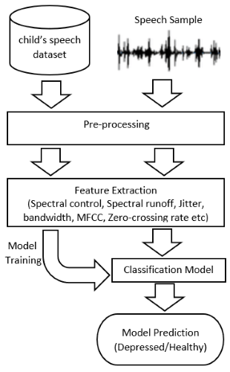
PROPOSED SYSTEM MODEL
Fig 1 : High Level Diagram

Slide 8
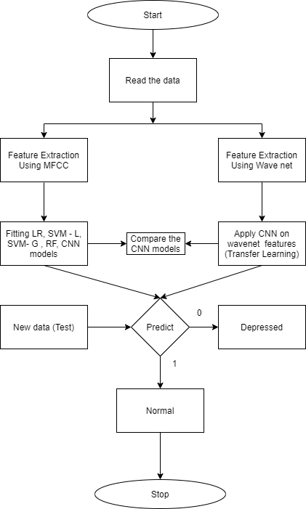
LOW LEVEL DIAGRAM OF THE MODEL

Slide 9
ADVANTAGES
The system proposed in this project is machine learning based that employs speech analysis of a child’s voice and uses four classification models to detect children with anxiety and depression.
viz. Logistic Regression, Random Forest, SVM Linear Kernel and SVM Gaussian Kernel.
In the proposed system, an application is created which processes any new data and classifies them as depressed or normal.
Any new speeches can be recorded in the application itself and simultaneously used for prediction.
The model is trained using four models that gives better accuracy than the existing system. This approach takes less computation time and is cost effective.

Slide 10
WAVENET AND CNN
WaveNet is a deep neural network for generating raw audio. It was created by researchers at London-based artificial intelligence firm DeepMind.
By using the concept of Transfer Learning, we have used WaveNet feature extraction model on top of CNN and compared the results with a CNN model built using features extracted from the inbuilt MFCC in Librosa.
40 observations in 8 features are extracted using MFCC and 848 observations among all features are extracted using WaveNet. These features are fed to the same CNN classifier model.

Slide 11
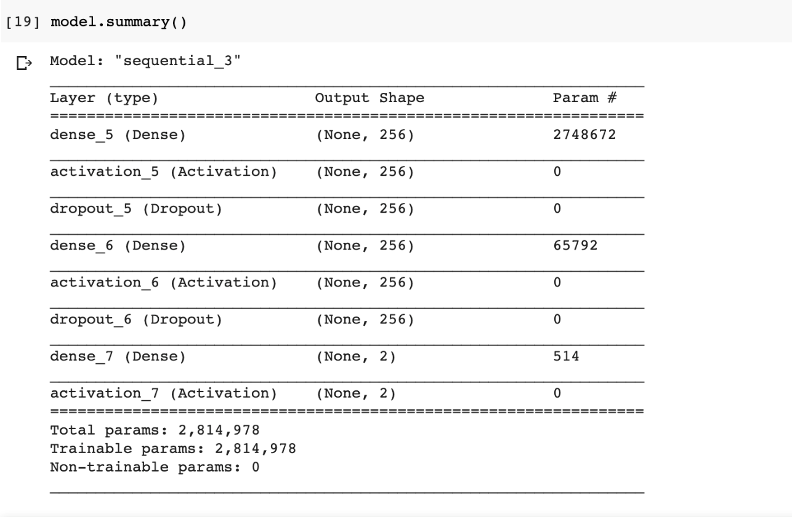
5. CONVOLUTION NEURAL NETWORK (CNN)

Slide 12
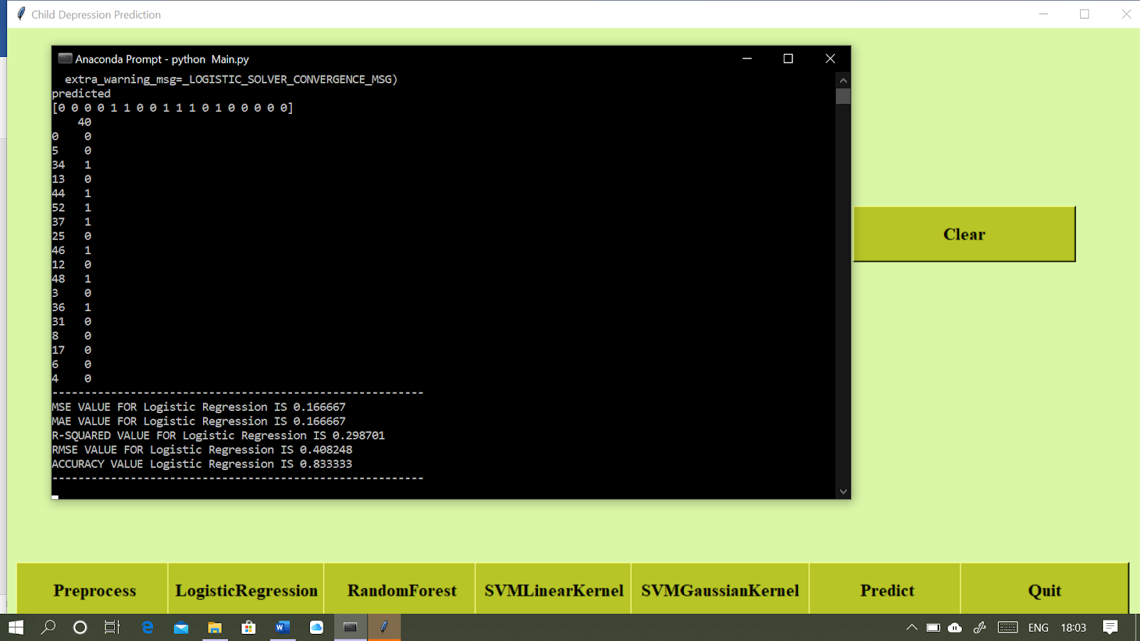
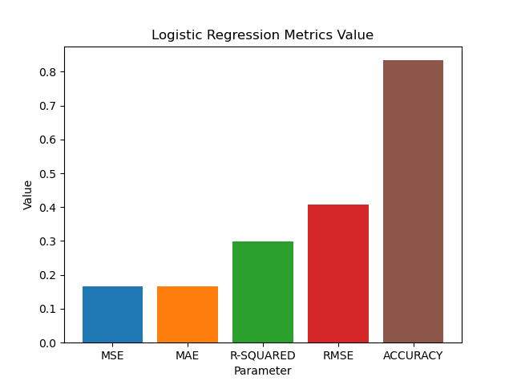
OUTPUT
1. LOGISTIC REGRESSION

Slide 13
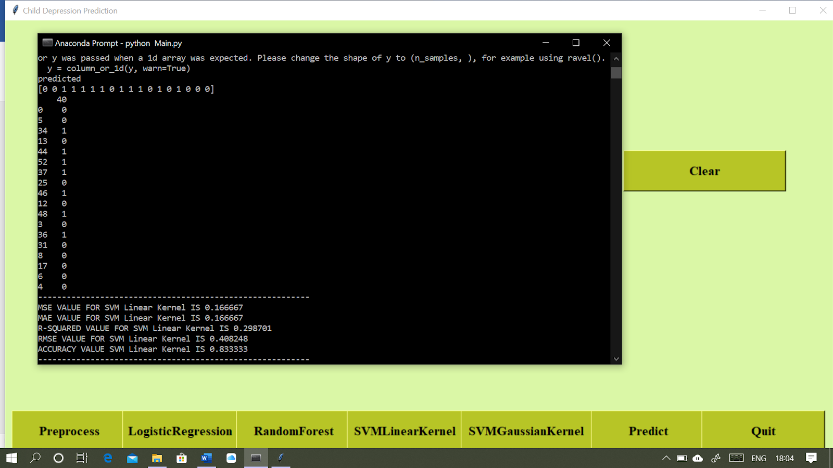

2. SVM LINEAR KERNEL

Slide 14

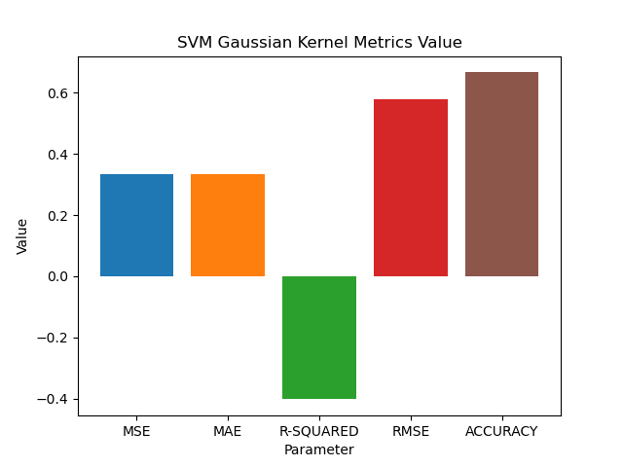
3. SVM GAUSSIAN KERNEL

Slide 15

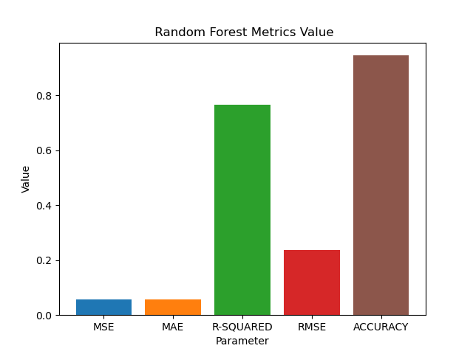
4. RANDOM FOREST

Slide 16
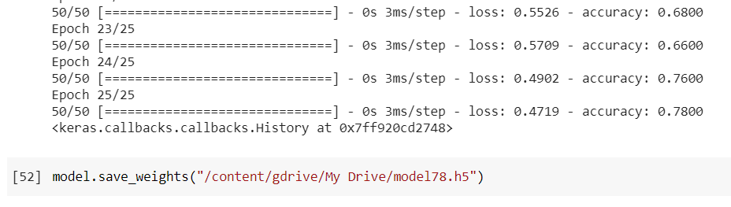
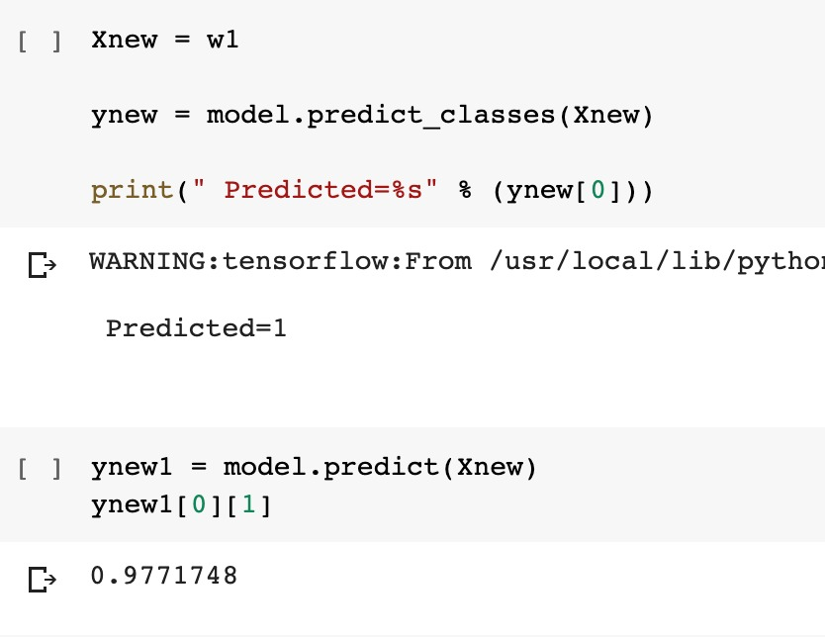
CNN with WaveNet

Slide 17
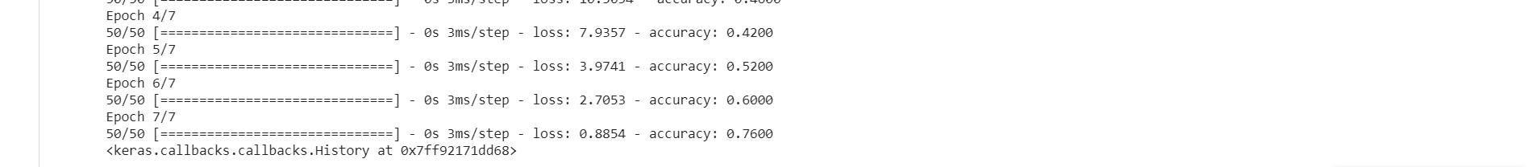
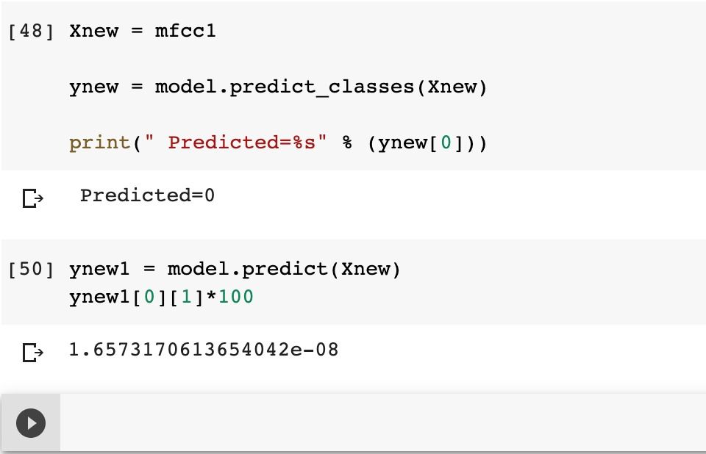
CNN with MFCC

Slide 18
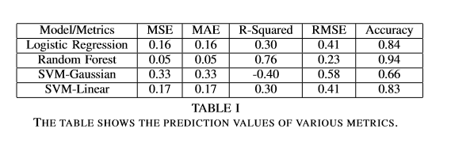
RESULT
The comparative analysis carried out between CNN using MFCC features and CNN using WaveNet features show that WaveNet produced more reliable and robust features.
.
When MFCC features were used on CNN, it resulted in 76% prediction accuracy whereas the transfer learning model showed an accuracy of 78%. But since the data here is smaller in quantity, overfitting has lead to the decrease in the accuracy of the WaveNet. But in normal circumstances with larger amount of data, transfer learning is the most efficient model.

Slide 19
CONCLUSION
This application will act as a primary tool for automating the system of detecting if a person is depressed or not.
A detailed analysis of the audio features selected for this classification showed that affected children show low-pitch voices.
This model of statistical pattern recognition performs better clinical thresholds on parent-reported child diagnoses collected and indicates its ability within this community as an unbiased diagnostic tool.
In future with this as the base reference, the accuracy of the models can be increased to provide more accurate results for the test audio data.

Slide 20
REFERENCES
[1]. France, D. J., Shiavi, R. G., Silverman, S., Silverman, M., & Wilkes, M. (2000). “Acoustical properties of speech as indicators of depression and suicidal risk”. IEEE Transactions on Biomedical Engineering, 47(7), 829–837.
[2]. Moore, E., Clements, M. A., Peifer, J. W., & Weisser, L. (2008). “Critical Analysis of the Impact of Glottal Features in the Classification of Clinical Depression in Speech”. IEEE Transactions on Biomedical Engineering, 55(1), 96–107.
[3]. Cummins, Nicholas & Epps, Julien & Breakspear, Michael & Goecke, Roland. (2011). “An Investigation of Depressed Speech Detection: Features and Normalization”. Proc. Interspeech. 2997-3000.
[4]. McGinnis, R. S., McGinnis, E. W., Hruschak, J., Lopez-Duran, N. L., Fitzgerald, K., Rosenblum, K. L., & Muzik, M. (2018). Rapid Anxiety and Depression Diagnosis in Young Children Enabled by Wearable Sensors and Machine Learning. 2018 40th Annual International Conference of the IEEE Engineering in Medicine and Biology Society (EMBC).
[5]. McGinnis, E. W., Anderau, S. P., Hruschak, J., Gurchiek, R. D., Lopez-Duran, N. L., Fitzgerald, K., … McGinnis, R. (2019). Giving Voice to Vulnerable Children: Machine Learning Analysis of Speech Detects Anxiety and Depression in Early Childhood. IEEE Journal of Biomedical and Health Informatics, 1–1.

Slide 21
[6]. Chu-Xiong Qin, Dan Qu and Lian-Hai Zhang.”Towards end-to-end speech recognition with transfer learning”. Qin et al. EURASIP Journal on Audio, Speech, and Music Processing (2018) 2018:18
[7]. Paula Lopez-Otero, Laura Docio-Fernandez, Carmen Garcia-Mateo. “A Study of acoustic features for Depression Detection”, IEEE 2014.
[8]. Ying Yang, Catherine Fairbairn, and Jeffrey F. Cohn, Associate Member, IEEE “Detecting Depression Severity from Vocal Prosody”, IEEE TRANSACTIONS ON AFFECTIVE COMPUTING, VOL. 4, NO. 2
[9]. Le Yang “Multi-Modal Depression Detection and Estimation”. 2019 8th International Conference on Affective Computing and Intelligent Interaction Workshops and Demos (ACIIW)
[10]. Jinming Li,Xiaoyan Fu ,d Zhuhong Shao, Yuanyuan Shang.“Improvement on Speech Depression Recognition Based on Deep Networks”, IEEE 2018.

Slide 22
[11] Harati, S., Crowell, A., Mayberg, H., & Nemati, S. (2018). Depression Severity Classification from Speech Emotion. 2018 40th Annual International Conference of the IEEE Engineering in Medicine and Biology Society (EMBC).
[12] Lam, G., Dongyan, H., & Lin, W. (2019). Context-aware Deep Learning for Multi-modal Depression Detection. ICASSP 2019 - 2019 IEEE International Conference on Acoustics, Speech and Signal Processing (ICASSP).
[13] Zhao, Z., Bao, Z., Zhang, Z., Deng, J., Cummins, N., Wang, H., … Schuller, B. (2019). Automatic Assessment of Depression from Speech via a Hierarchical Attention Transfer Network and Attention Autoencoders. IEEE Journal of Selected Topics in Signal Processing, 1–1.
[14] Rani, B. (2016). Detecting depression: A comparison between I-Vector 56 technique and fuzzy membership functions. 2016 International Conference on Inventive Computation Technologies (ICICT).
[15] Huang, Z., Epps, J., Joachim, D., & Sethu, V. (2019). Natural Language Processing Methods for Acoustic and Landmark Event-based Features in Speechbased Depression Detection. IEEE Journal of Selected Topics in Signal Processing, 1–1.

